Slide 1
javascript

Slide 2
Python vs javascript
Python was engineered to be beautiful
Javascript was built in 10 days by one coder
JS was built to be scheme, but at the last minute they changed it to be more c like
So … it’s a bit strange
But it powers a lot of the internet

Slide 3

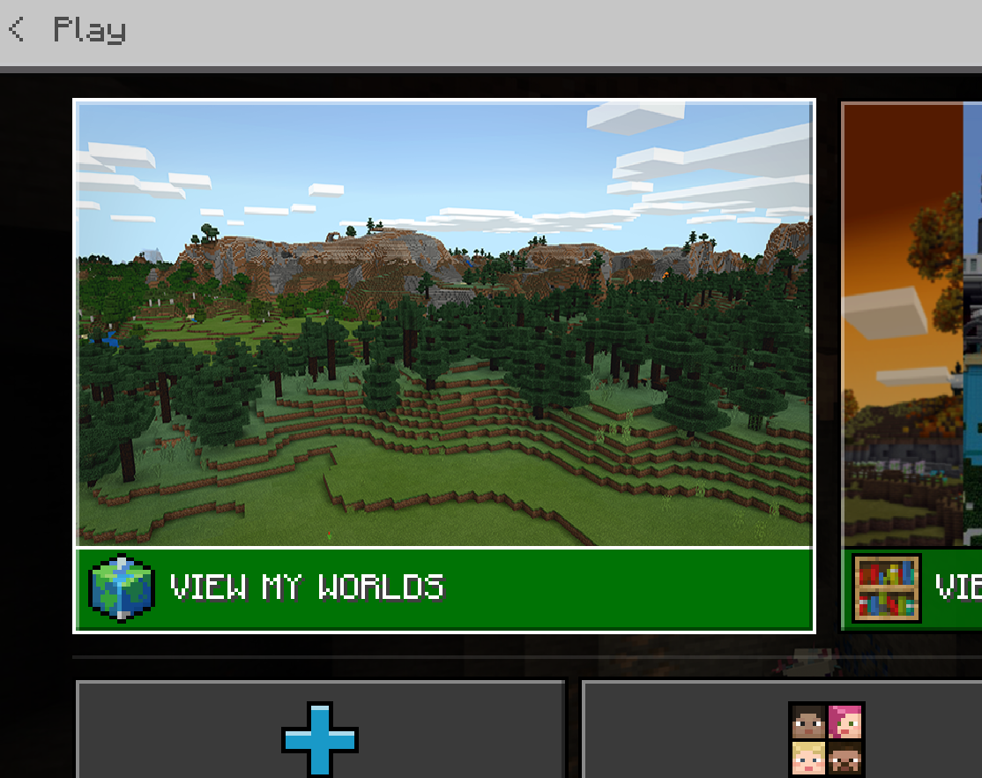

Slide 4
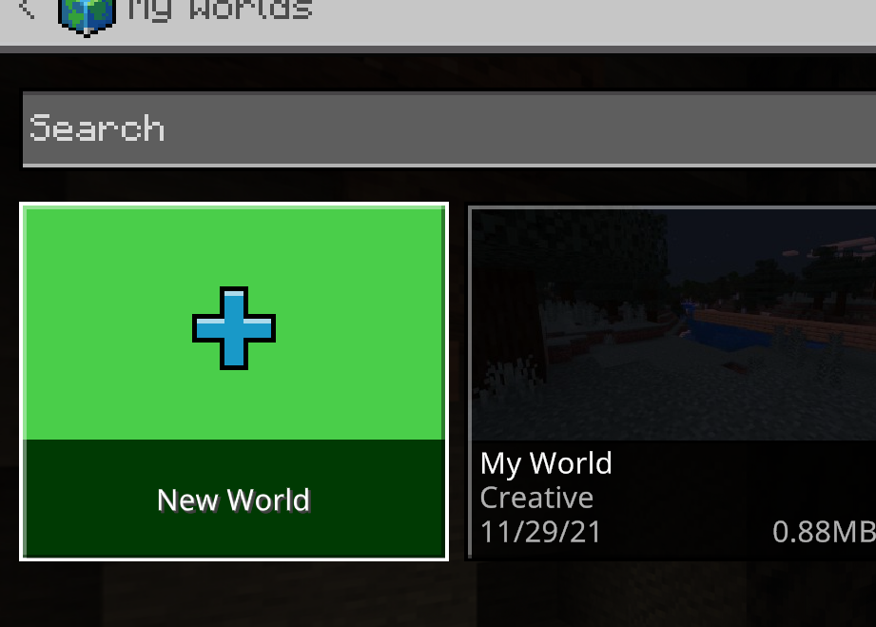

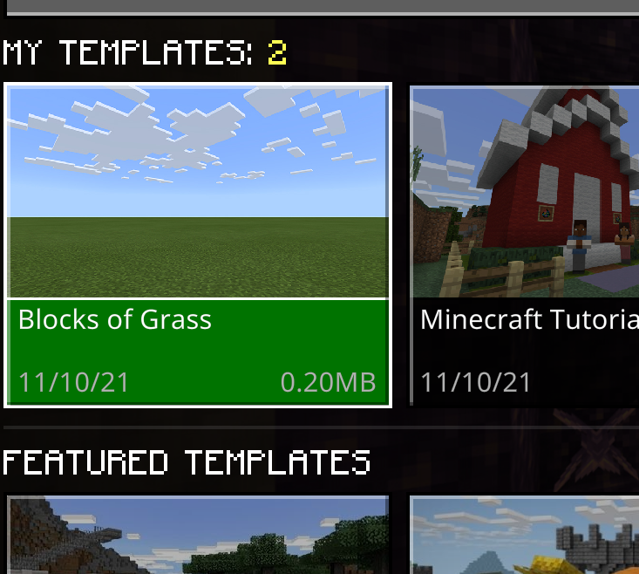

Slide 5
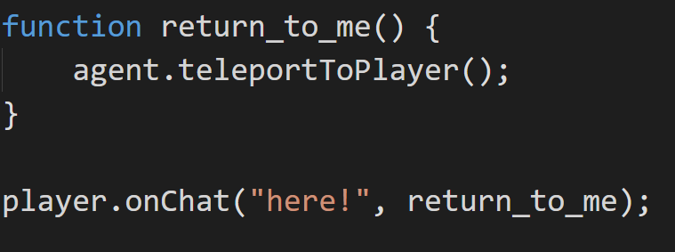

Slide 6

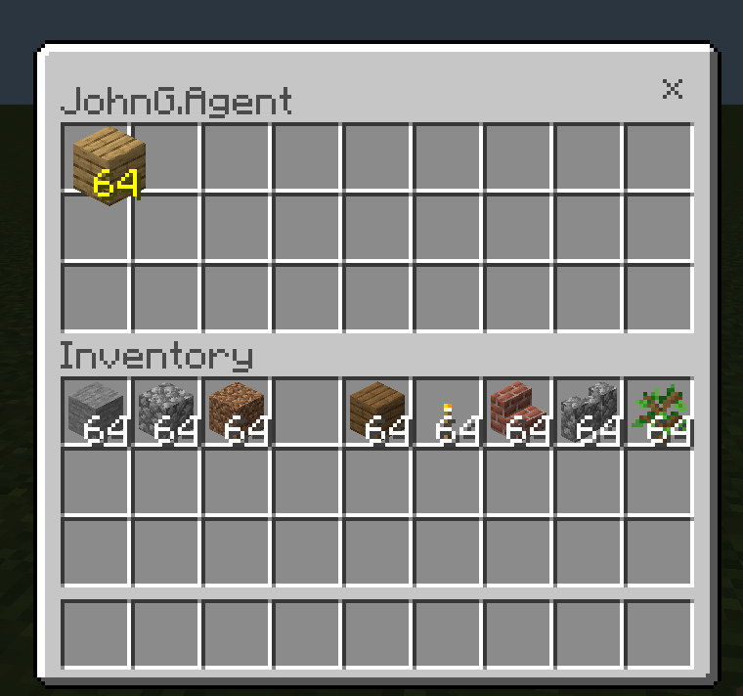
Right click
Drag and drop

Slide 7
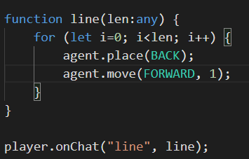
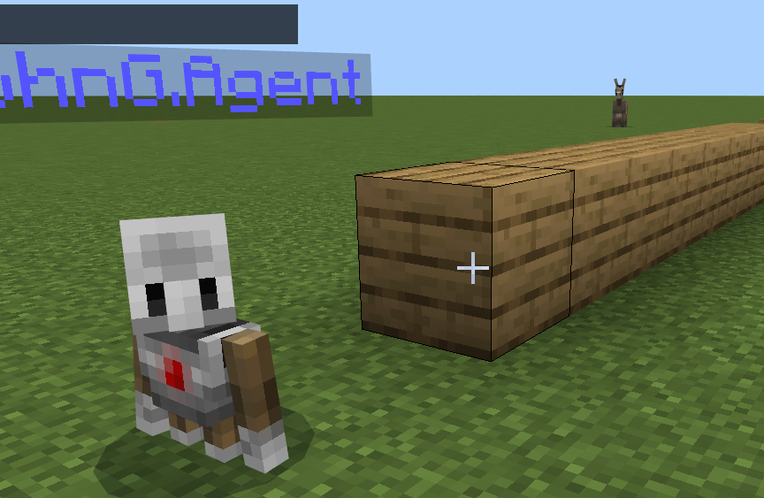
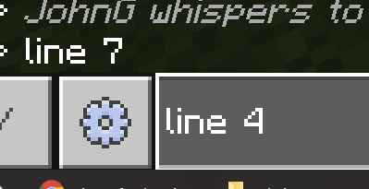
1 parameter
“t” to talk
“line 4” calls function line, with parameter 4

Slide 8
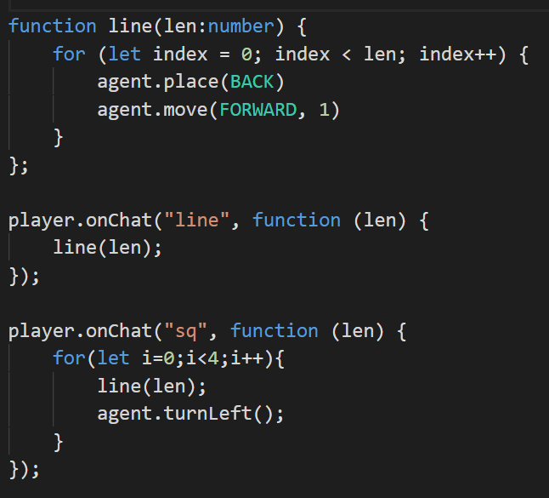
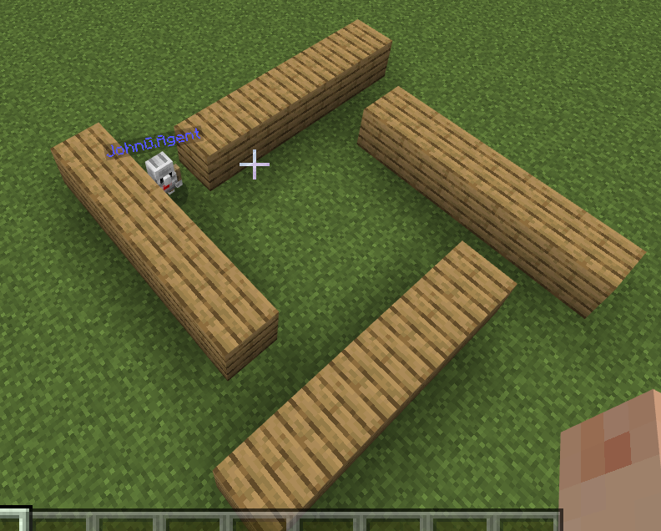

Slide 9
https://developer.mozilla.org/en-US/docs/Web/JavaScript/Guide/Introduction

Slide 10
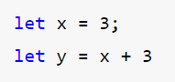
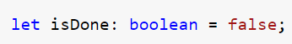
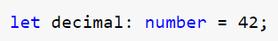
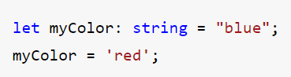
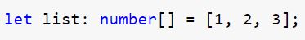
variables
No data type used, inference – inferred to be integer

Slide 11
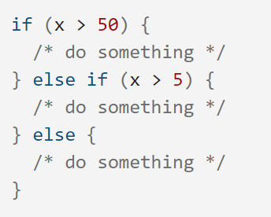
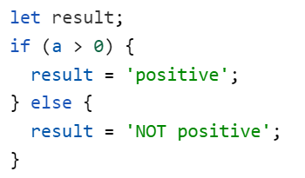
conditionals

Slide 12
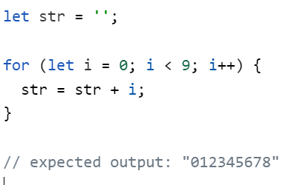
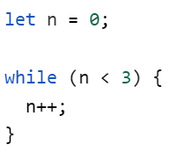
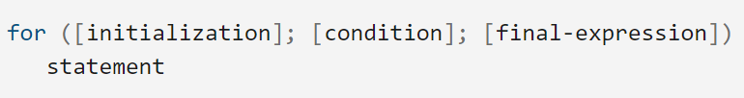
loops

Slide 13
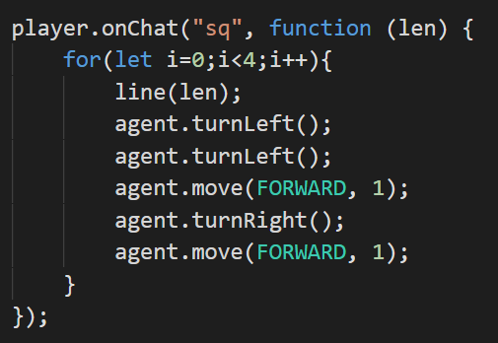
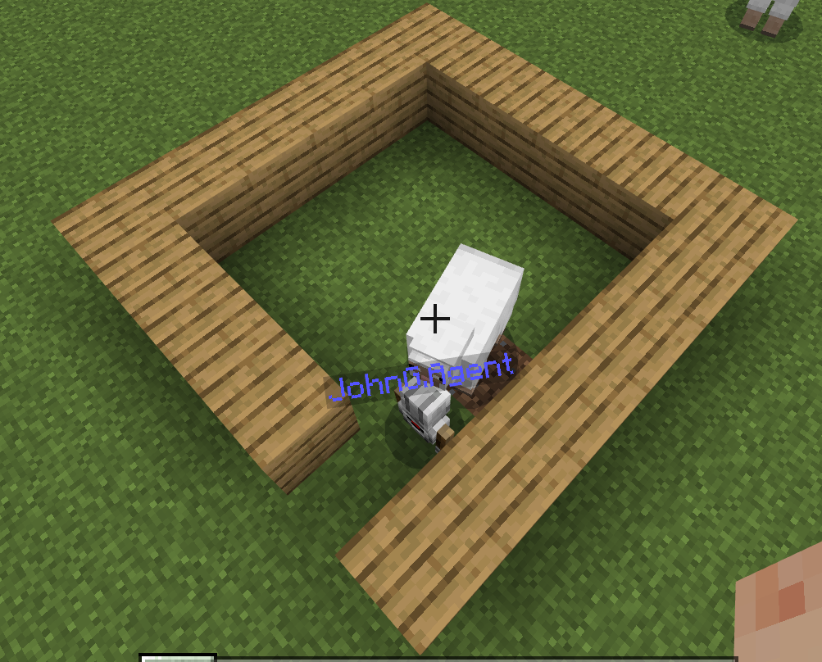

Slide 14
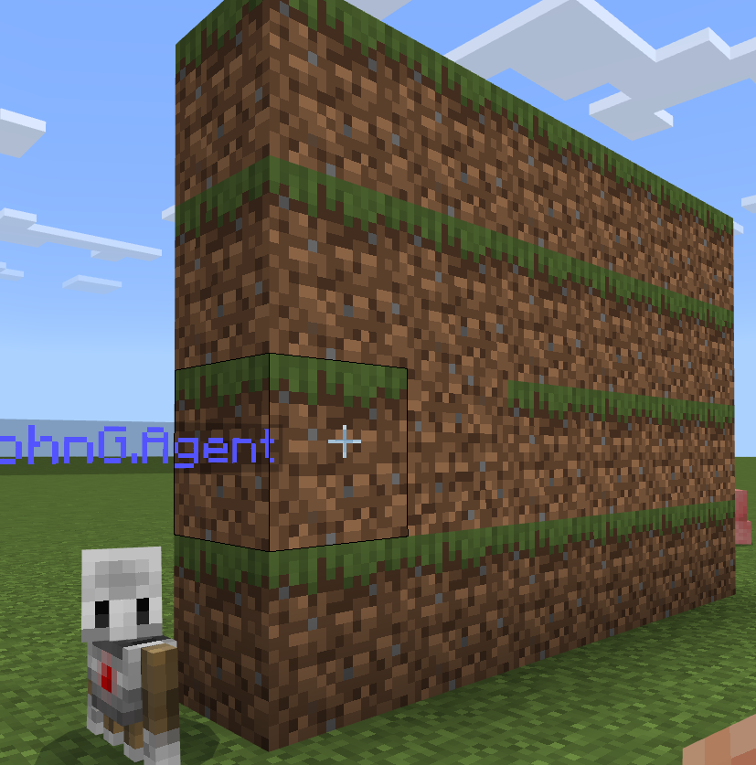
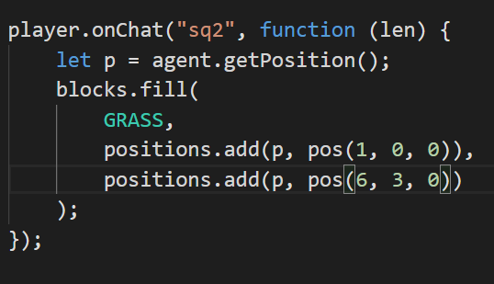
This is possible using blocks.fill command but I would prefer you to code the little robot ….
This is a coding module, after all ☺

Slide 15
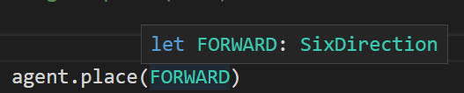
Mouse hover to inspect
Use to do coding:

Slide 16
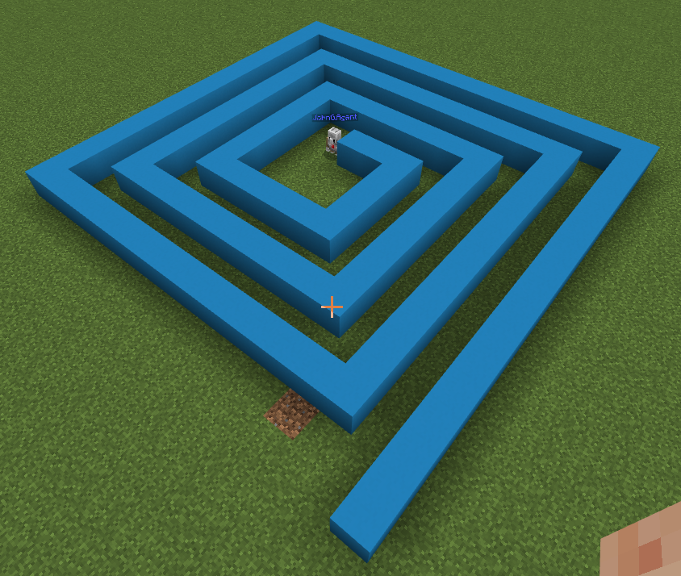
Challenges – can you complete the following:

Slide 17
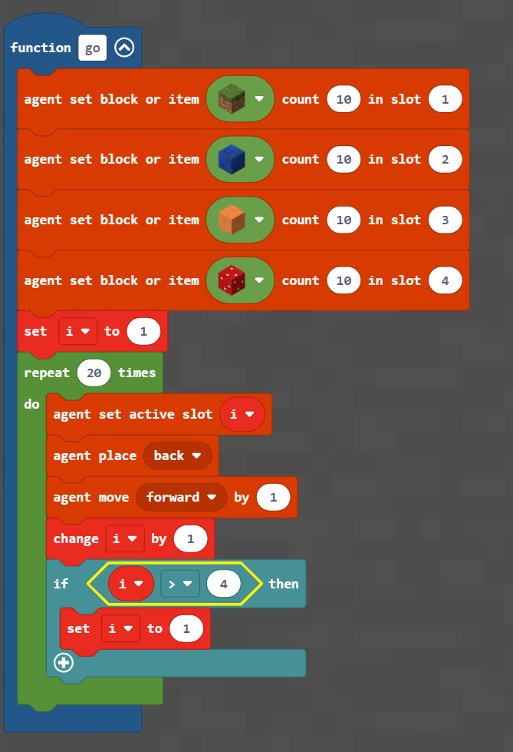
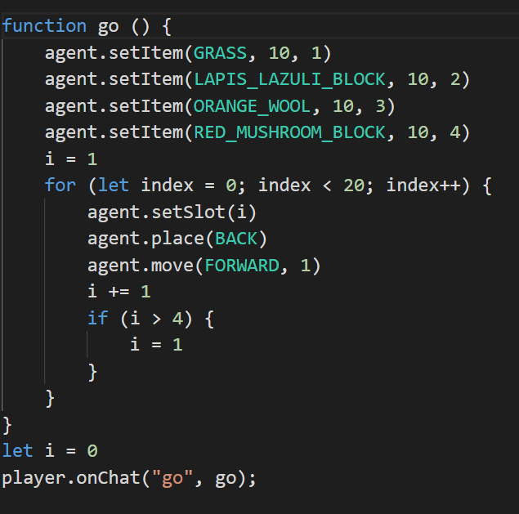
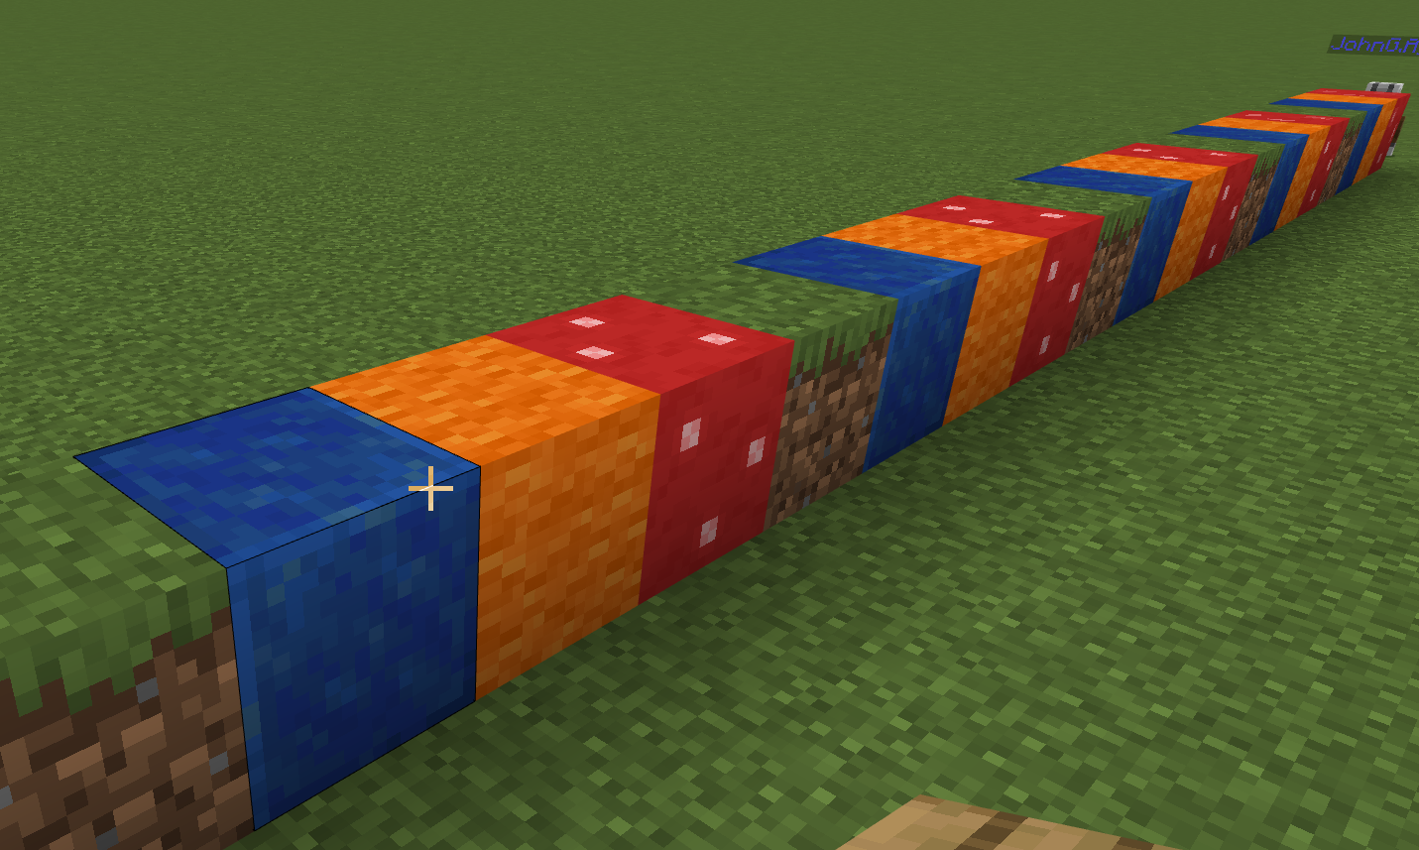
Morse code writer – enter your name, robot outputs morse code.
Also – try binary numbers.

Slide 18
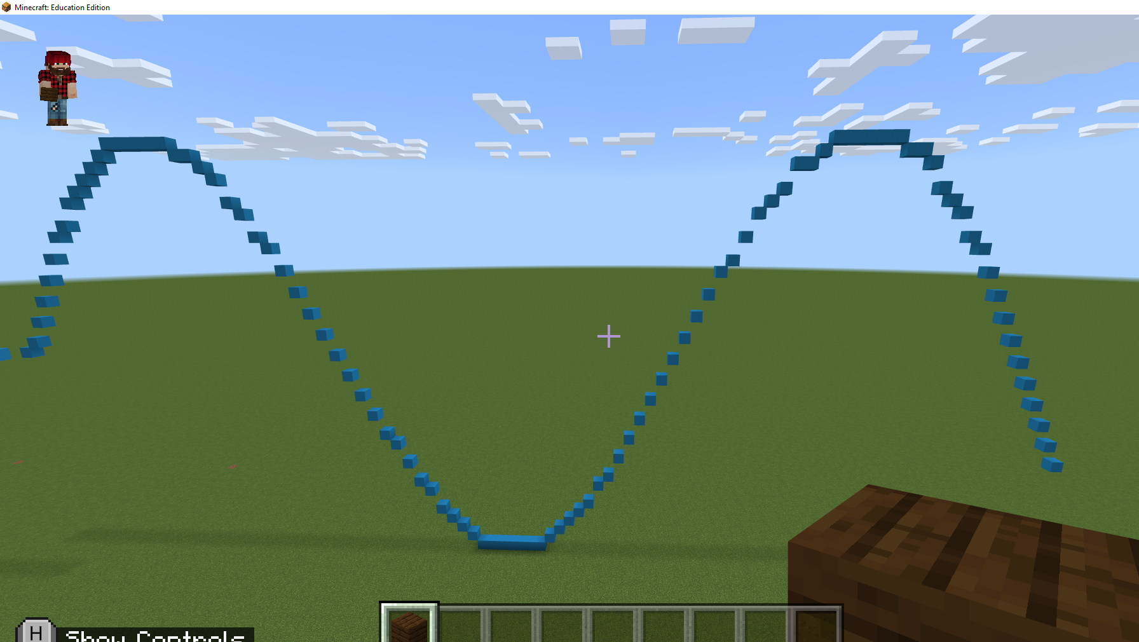
Sin wave
Extension:
Circle
rainbow
https://replit.com/@JohnGlazebrook/js-sin-wave#script.js

Slide 19
Morse code writer – enter your name, robot outputs morse code.
Also – try binary numbers.

Slide 20
Maze solver

Slide 21
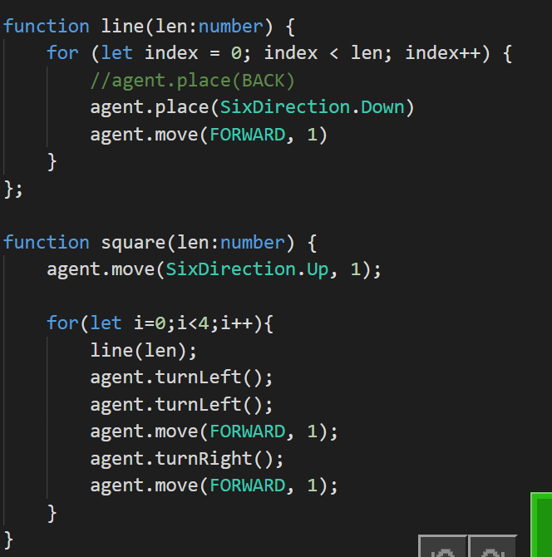
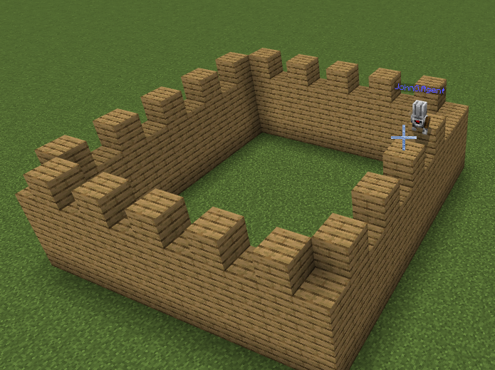
Place each block BELOW the agent

